Slide 1



TỔNG HỢP
TÌNH HÌNH KINH TẾ - XÃ HỘI
Tháng 10 và 10 tháng đầu năm 2024
(Nguồn: Tổng cục Thống kê)
cfcvietnam.vn

Slide 2



Slide 3



Join with us

Slide 4
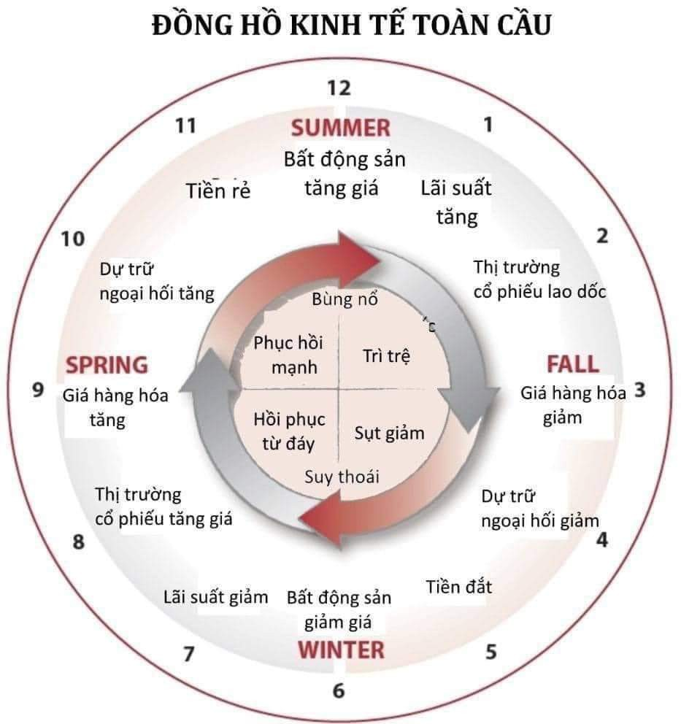




08.2371.3456
cfcvietnam.vn

Slide 5


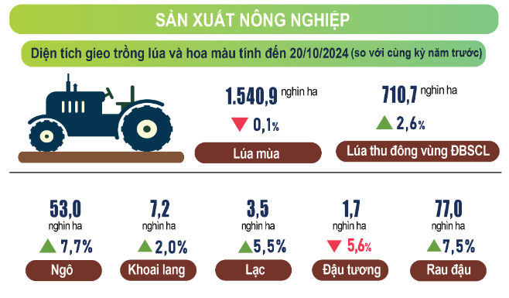




0823.71.3456
0823.71.3456
https://cfcvietnam.vn/
0823.71.3456
https://cfcvietnam.vn/
0823.71.3456
https://cfcvietnam.vn/
https://cfcvietnam.vn/

Slide 6
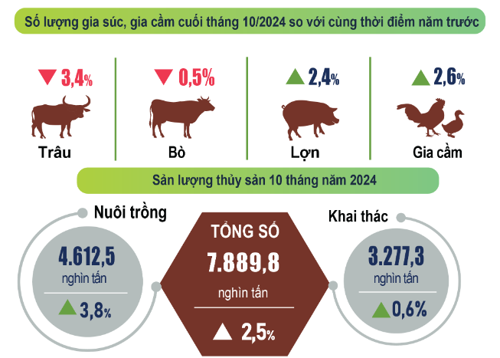
0823.71.3456
0823.71.3456
https://cfcvietnam.vn/
0823.71.3456
https://cfcvietnam.vn/
0823.71.3456
https://cfcvietnam.vn/
https://cfcvietnam.vn/

Slide 7
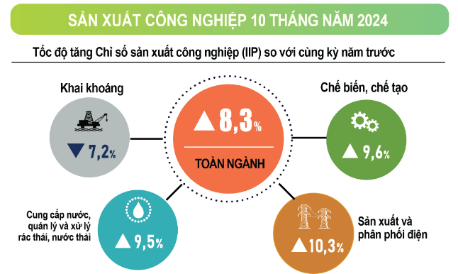
0823.71.3456
0823.71.3456
https://cfcvietnam.vn/
0823.71.3456
https://cfcvietnam.vn/
0823.71.3456
https://cfcvietnam.vn/
https://cfcvietnam.vn/

Slide 8
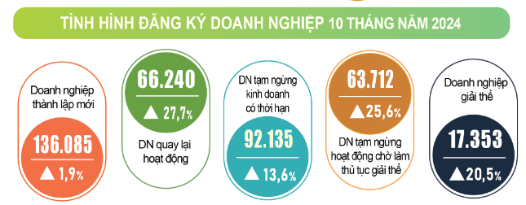
0823.71.3456
0823.71.3456
https://cfcvietnam.vn/
0823.71.3456
https://cfcvietnam.vn/
0823.71.3456
https://cfcvietnam.vn/
https://cfcvietnam.vn/

Slide 9
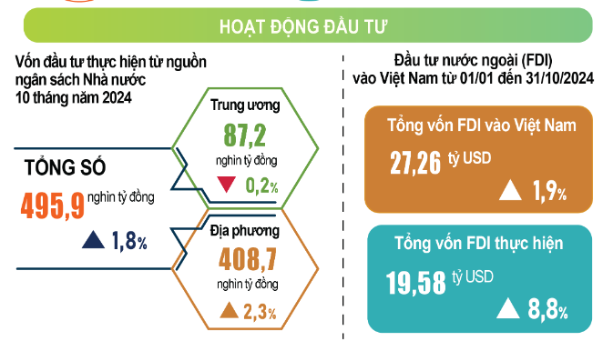
0823.71.3456
0823.71.3456
https://cfcvietnam.vn/
0823.71.3456
https://cfcvietnam.vn/
0823.71.3456
https://cfcvietnam.vn/
https://cfcvietnam.vn/

Slide 10
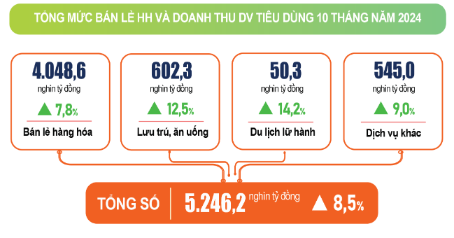
0823.71.3456
0823.71.3456
https://cfcvietnam.vn/
0823.71.3456
https://cfcvietnam.vn/
0823.71.3456
https://cfcvietnam.vn/
https://cfcvietnam.vn/

Slide 11
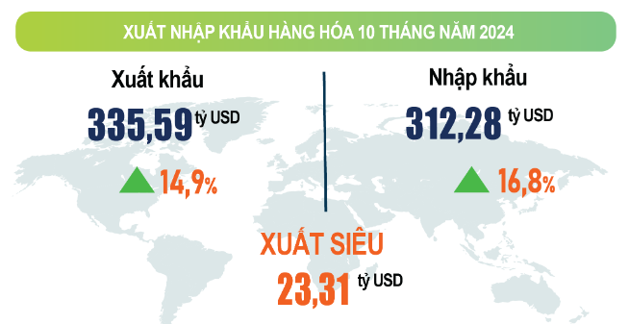
0823.71.3456
0823.71.3456
https://cfcvietnam.vn/
0823.71.3456
https://cfcvietnam.vn/
0823.71.3456
https://cfcvietnam.vn/
https://cfcvietnam.vn/

Slide 12
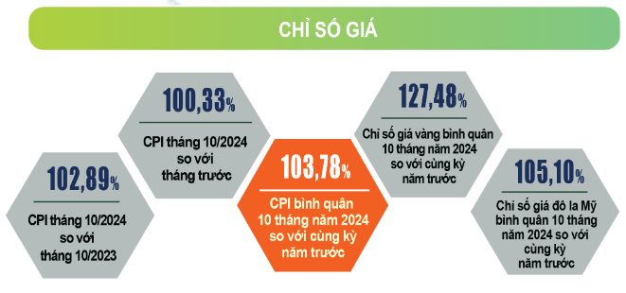
0823.71.3456
0823.71.3456
https://cfcvietnam.vn/
0823.71.3456
https://cfcvietnam.vn/
0823.71.3456
https://cfcvietnam.vn/
https://cfcvietnam.vn/

Slide 13
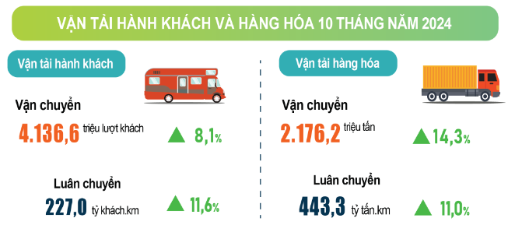
0823.71.3456
0823.71.3456
https://cfcvietnam.vn/
0823.71.3456
https://cfcvietnam.vn/
0823.71.3456
https://cfcvietnam.vn/
https://cfcvietnam.vn/

Slide 14
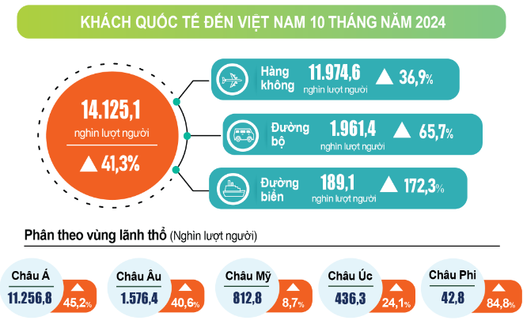
0823.71.3456
0823.71.3456
https://cfcvietnam.vn/
0823.71.3456
https://cfcvietnam.vn/
0823.71.3456
https://cfcvietnam.vn/
https://cfcvietnam.vn/

Slide 15
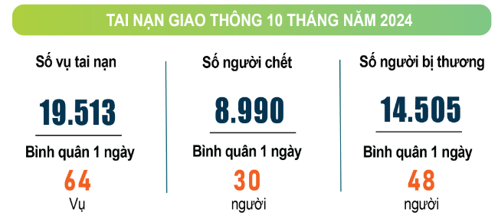
0823.71.3456
0823.71.3456
https://cfcvietnam.vn/
0823.71.3456
https://cfcvietnam.vn/
0823.71.3456
https://cfcvietnam.vn/
https://cfcvietnam.vn/

Slide 16

Đăng ký tư vấn
0823.71.3456
0823.71.3456
https://cfcvietnam.vn/
0823.71.3456
https://cfcvietnam.vn/
0823.71.3456
https://cfcvietnam.vn/
https://cfcvietnam.vn/

Slide 17


BIẾT ƠN BẠN
VÌ ĐÃ LẮNG NGHE!

